Slide 1

Mobile Application for Marginalized Communities
ITERATION 3 Presentation

Slide 2
Brief Outline
Introduction
Gantt Chart
Risks
Analysis Diagrams
Design Considerations
Demo
Limitations

Slide 3
Luminus Solutions
Team Member | Role
NONHLANHLA MABUZA | SCRUM MASTER
ASHLEY GARDNER | ANALYST
NICOLAN REDDY | ANALYST
LWANDO SOBEKWA | DESIGNER
SINAKO CETYIWE | DESIGNER
SHANA-MICHELLE RABONDA | IMPLEMENTER

Slide 4
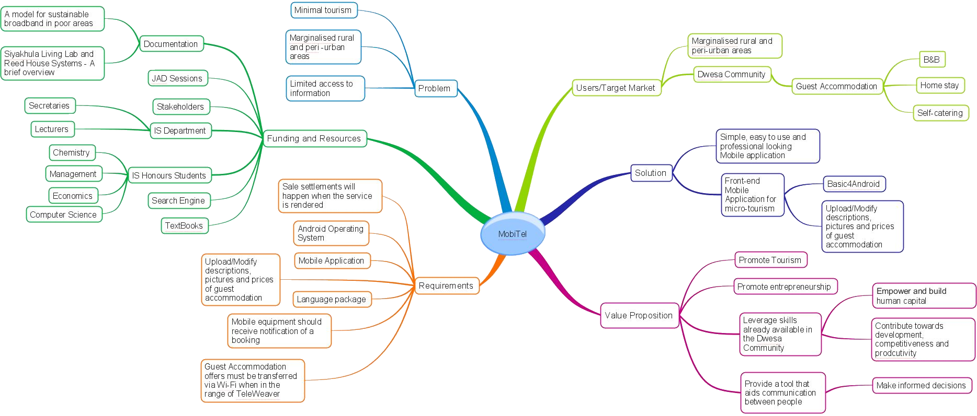
Mind map

Slide 5
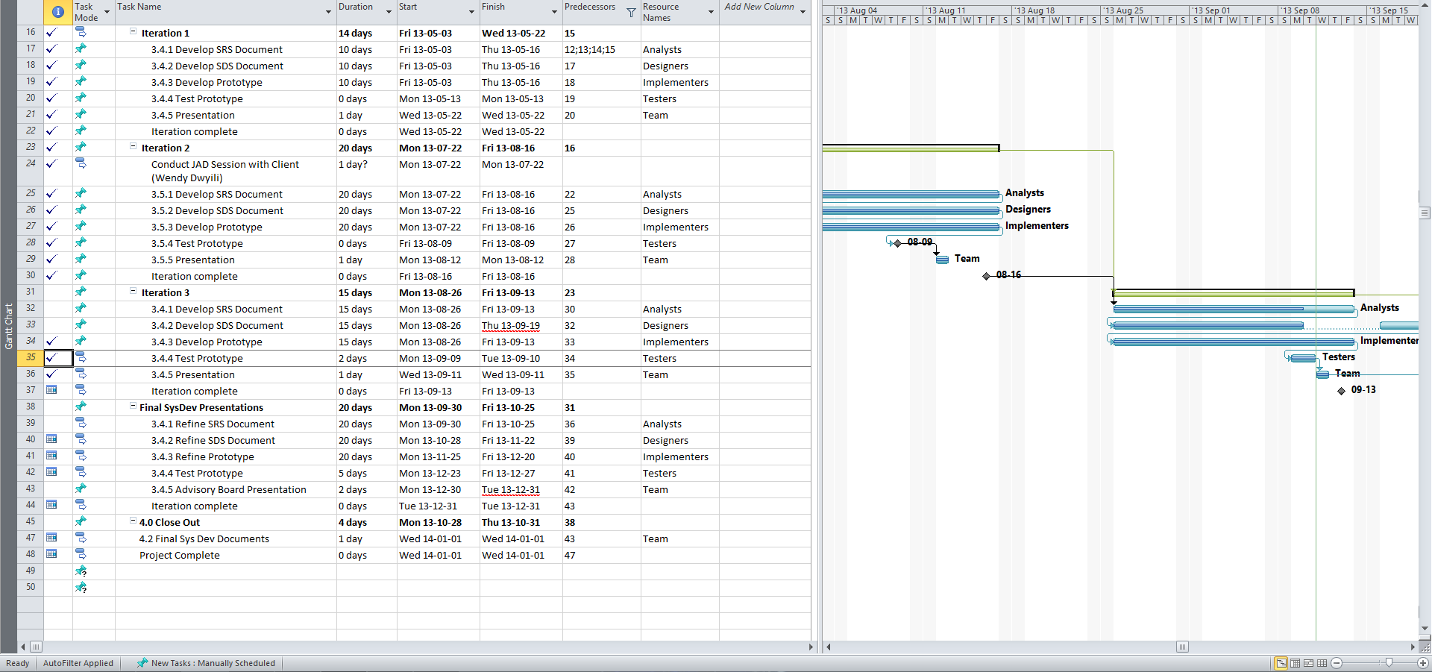
Gantt Chart

Slide 6
Risk Matrix
Risk | Potential Response | Impact
Failure to integrate with TeleWeaver | Agreement with Project Sponsor | Medium
Client Dissatisfaction | Management of expectations & open communication | Medium
Language Barrier | Training and | Medium
Loss of Data | Communication within the team | High
Scope Definition | Numerous meetings with various stakeholders | Medium

Slide 7
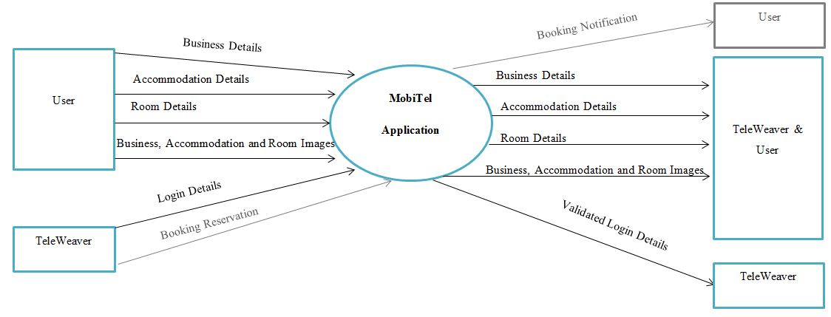
Context Diagram (MobiTel)

Slide 8
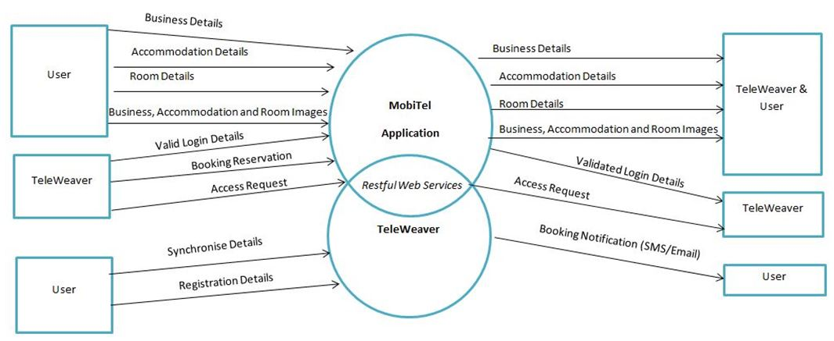
Context Diagram (TeleWeaver)

Slide 9
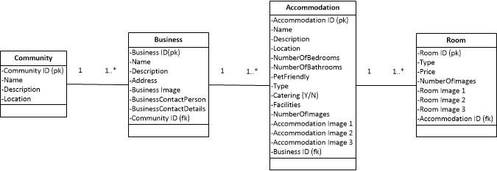
Class Diagram (Previous)

Slide 10
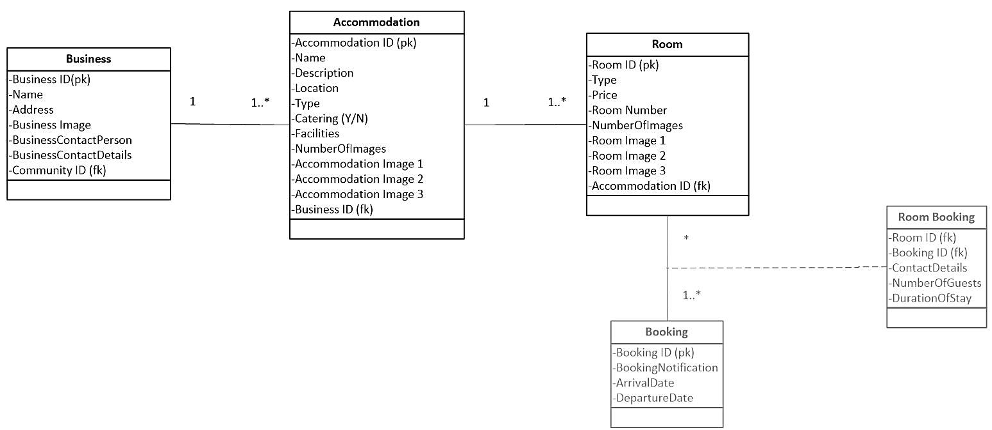
Class Diagram (Current)

Slide 11
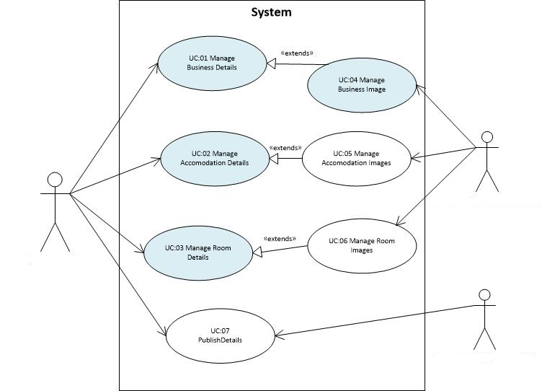
Use Case Diagram (Previous)
A01: Business Owner
A01: Business Owner
A02: TeleWeaver

Slide 12
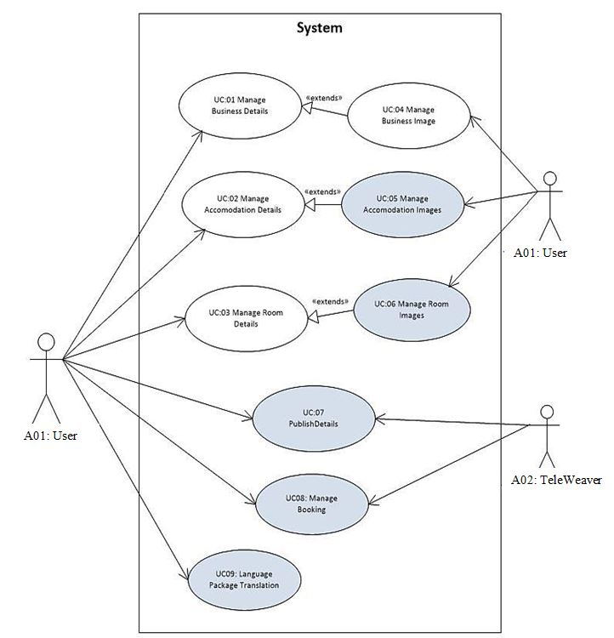
Use Case Diagram (Current)
Iteration 1: UC01
Iteration 2: UC01, UC02, UC03 and UC04
Iteration 3: UC05, UC06, UC07
*Out of Scope: UC08 and UC09

Slide 13
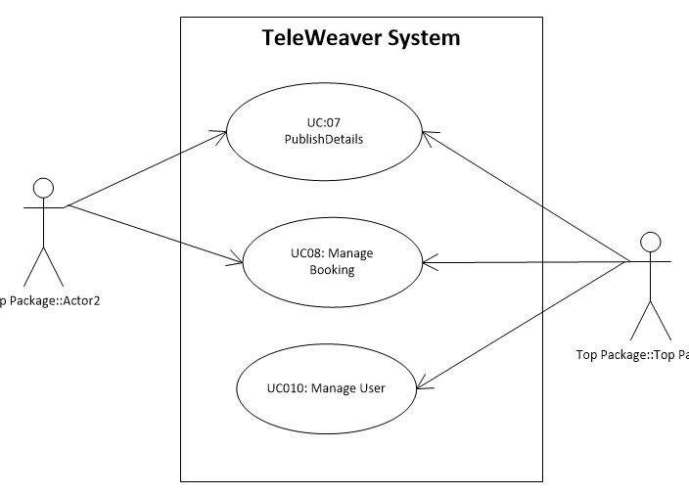
TeleWeaver’s Use case
A01: User
A02: TeleWeaver

Slide 14
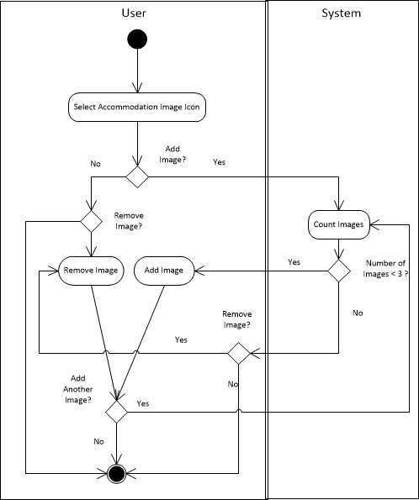
Activity Diagram
Use Case 05: Manage Accommodation Images

Slide 15
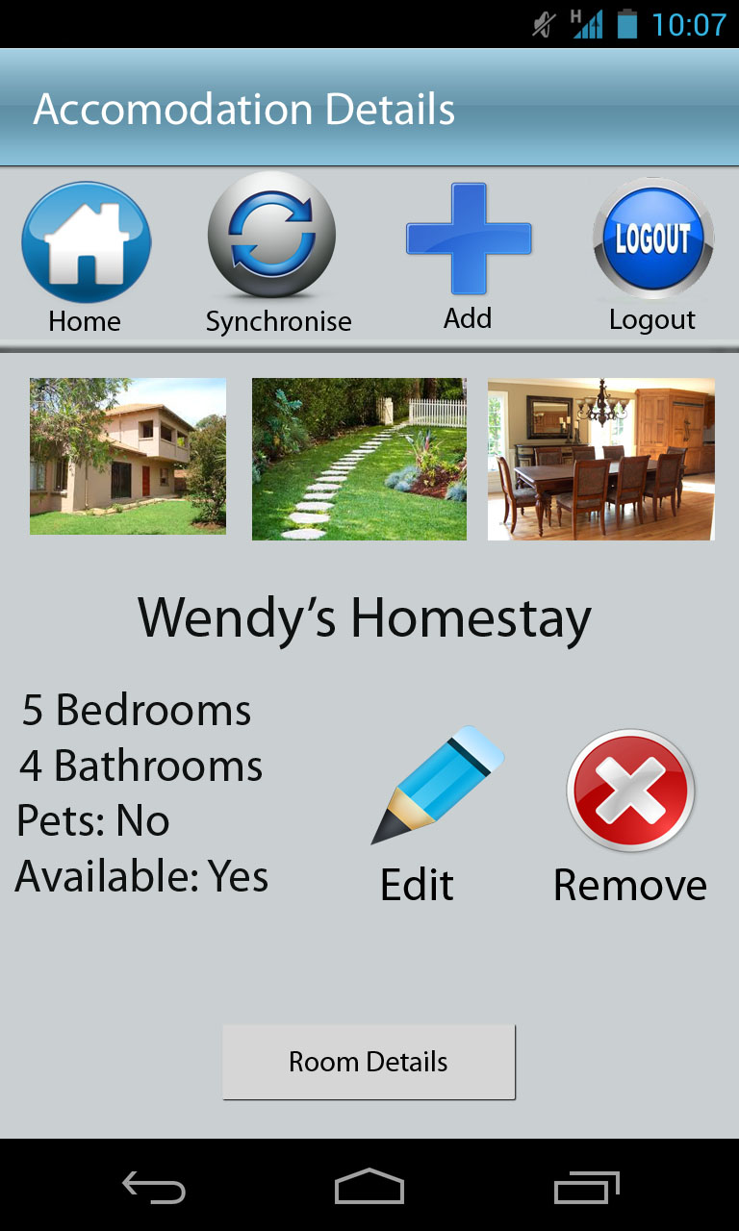
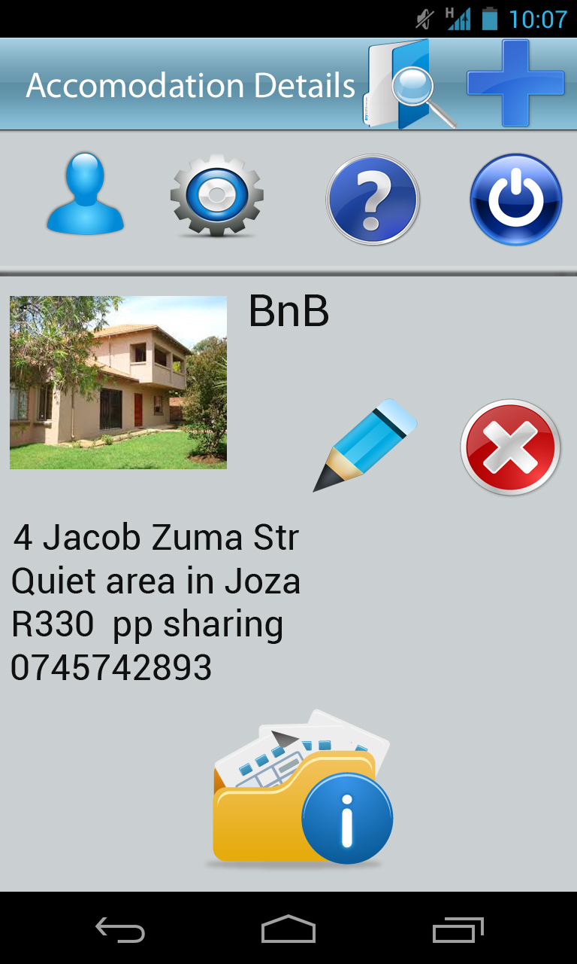
Design Considerations
Goals:
Usability
User Control and Freedom- clearly marked exits
Error Prevention – minimised error-prone conditions
Recognition v. recall – objects/actions/actions visible
User-friendliness
Simplicity
Minimalistic design
Aesthetics

Slide 16


Slide 17
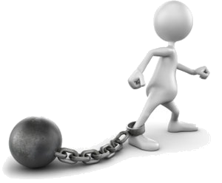
Limitations
Version Control
Language Localization
Memory
Few reference points for solutions
User Engagement
Testing

Slide 18


